Slide 1

Delta Airline sentinel
Executive Summary
Project Task-2
Prashant Raghuwanshi
DSC, Bellevue University
DSC640-T301 Data Presentation & Visualization (2223-1)
Professor Catie Williams
1/06/2022

Slide 2
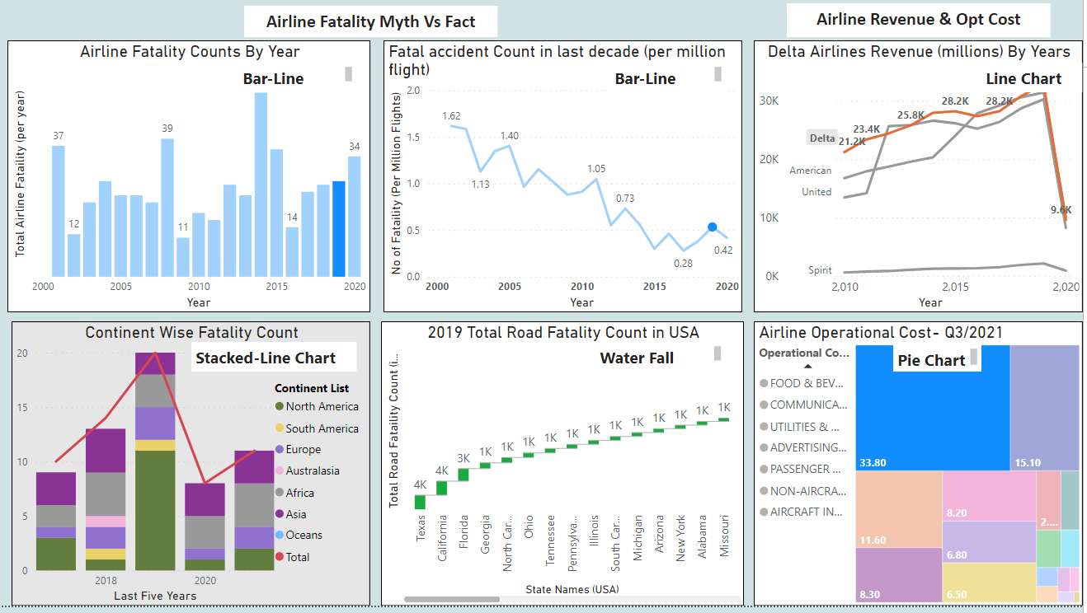
Executive Summary- Initial Set Up
Media Smoke
Airline Revenue
Costing Pressure
Recommendation
Legal and ethical considerations
References
Media Spreading Airline Safety concerns Vs Ground 0 Statistics Data
Post Covid Vs Covid-Revenue
Increase in Operational Cost
What did Data say?
Data Authenticity & PII Disclaimers
Data Sources

Slide 3
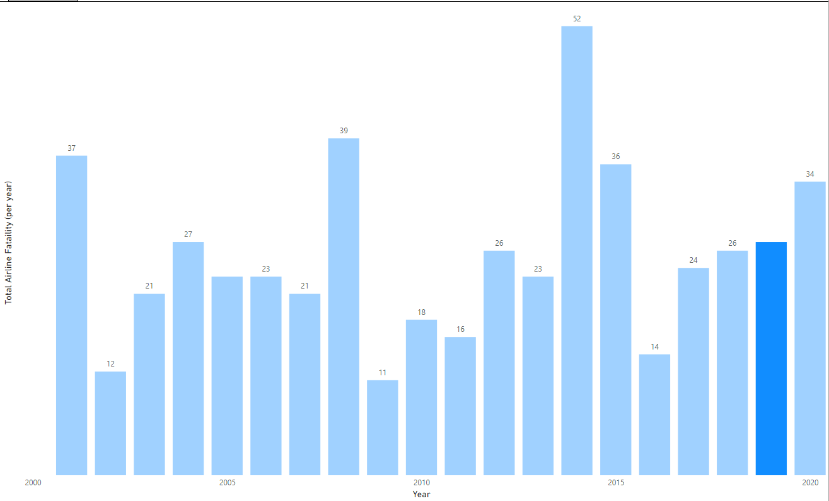
Media Smoke
Chart Showing Total Airline Fatality Per Year During Last Decade
Media Reported 27 Fatality in 2019
Is it Really a Huge No?
Next Slide
Source Data : Accidents and Fatalities Pery Year

Slide 4
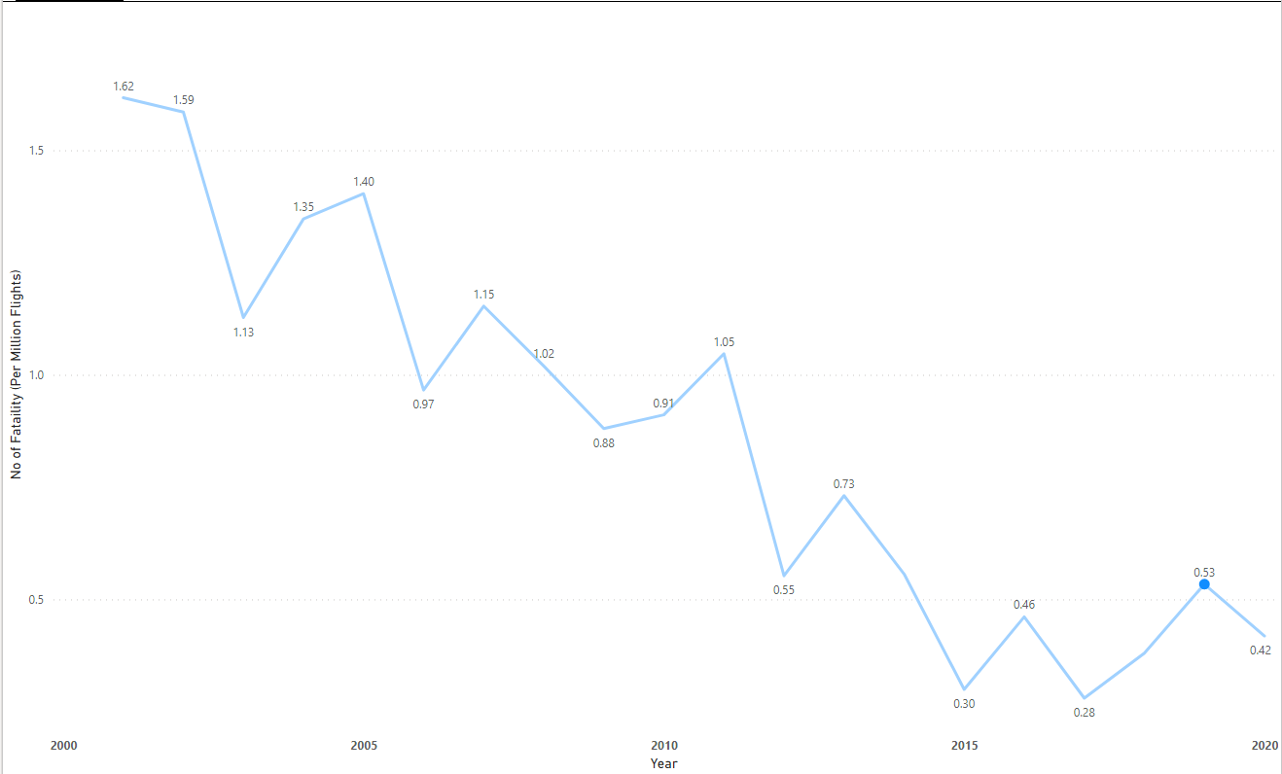
Media Smoke
Chart Showing decreasing Airline Fatality Counts per Million Flights during last Decade
Only 0.59 Fatality occurred / Million of scheduled flights in 2019
As compared to Air travel, Ground Mode of Travel is Really Safe?
Next Slide
Source Data : Accidents and Fatalities Pery Year

Slide 5
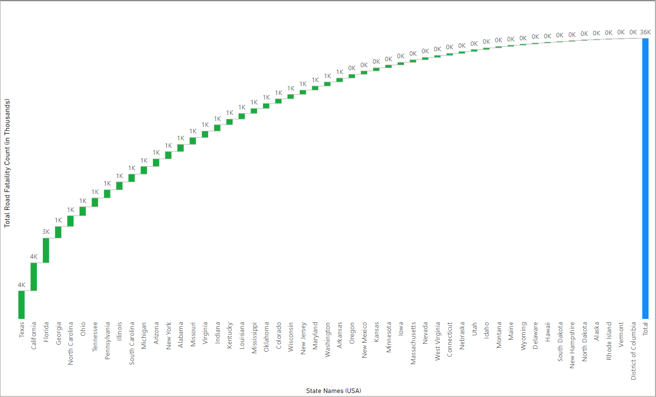
Media Smoke
Chart Showing Total Road Fatality in All States – 2019
Total Reported Road travel Fatality in 2019 was 36K
After comparing all three charts
Airline reported Fatality (worldwide) was way less & not comparable than the total ground fatality reported alone in the USA
Source Data : https://www.nhtsa.gov/data

Slide 6
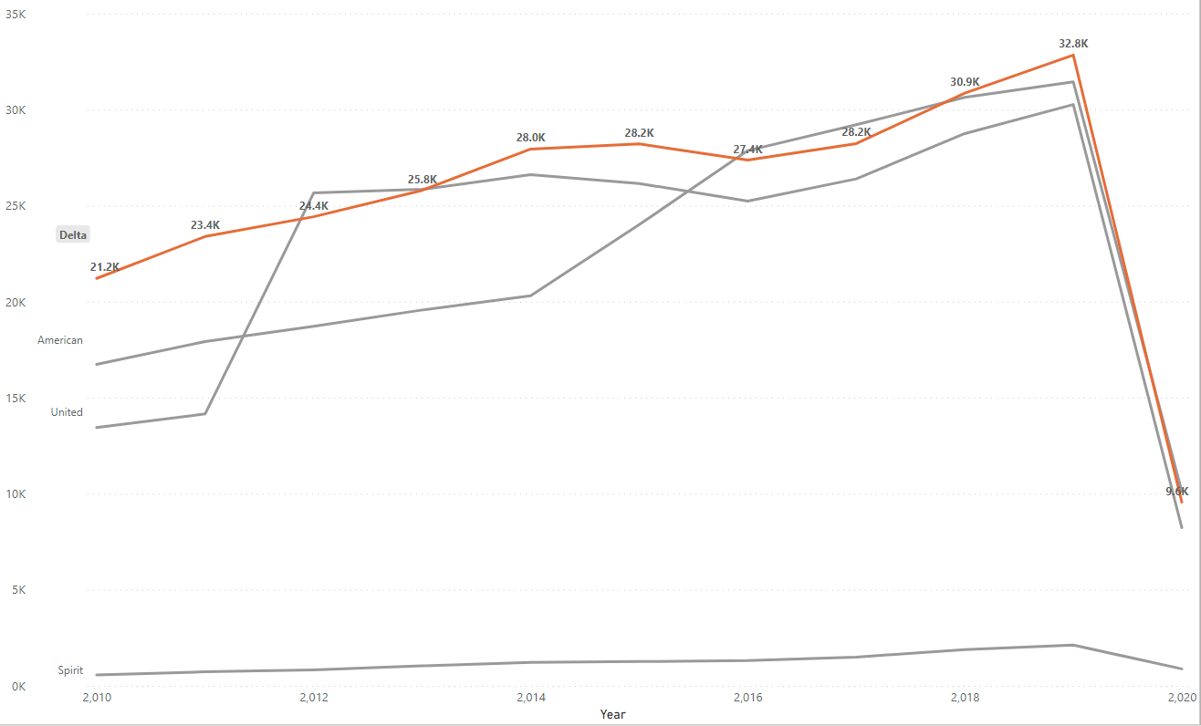
Airline Revenue
Pre Covid Vs Covid-Revenue
During Last Decade Delta was one of the consistently growing Airlines in terms of Revenue.
During 2020, due to International travel restrictions, all Airline company’s revenue declined to a decade low.
Source Data http://web.mit.edu/airlinedata/www/2020%2012%20Month%20Documents/Traffic%20and%20Capacity/System%20Total/Passenger%20Revenue%20--%20Total%20System%20Operations.htm

Slide 7
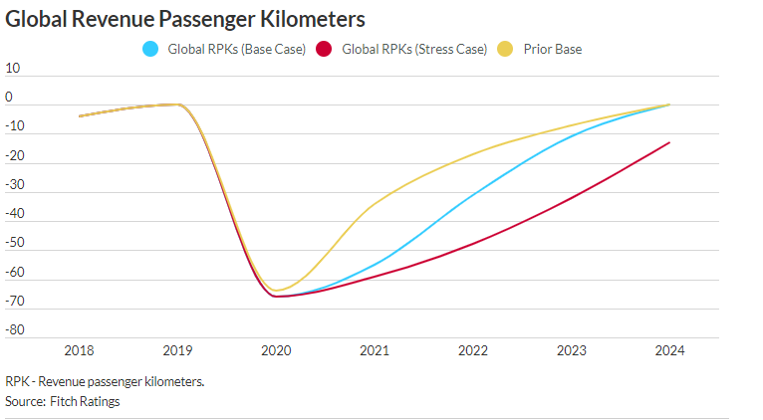
Airline Revenue
Post Covid Revenue
During 2022-2023, we are expecting the return of travel demand Near 2019
Global RPKs are projected to be approximately 55%, 30%, and 10% below pre-pandemic levels in 2021, 2022, and 2023, respectively.
Management Need to plan for upsizing the fleet capacity for 2022-2023

Slide 8
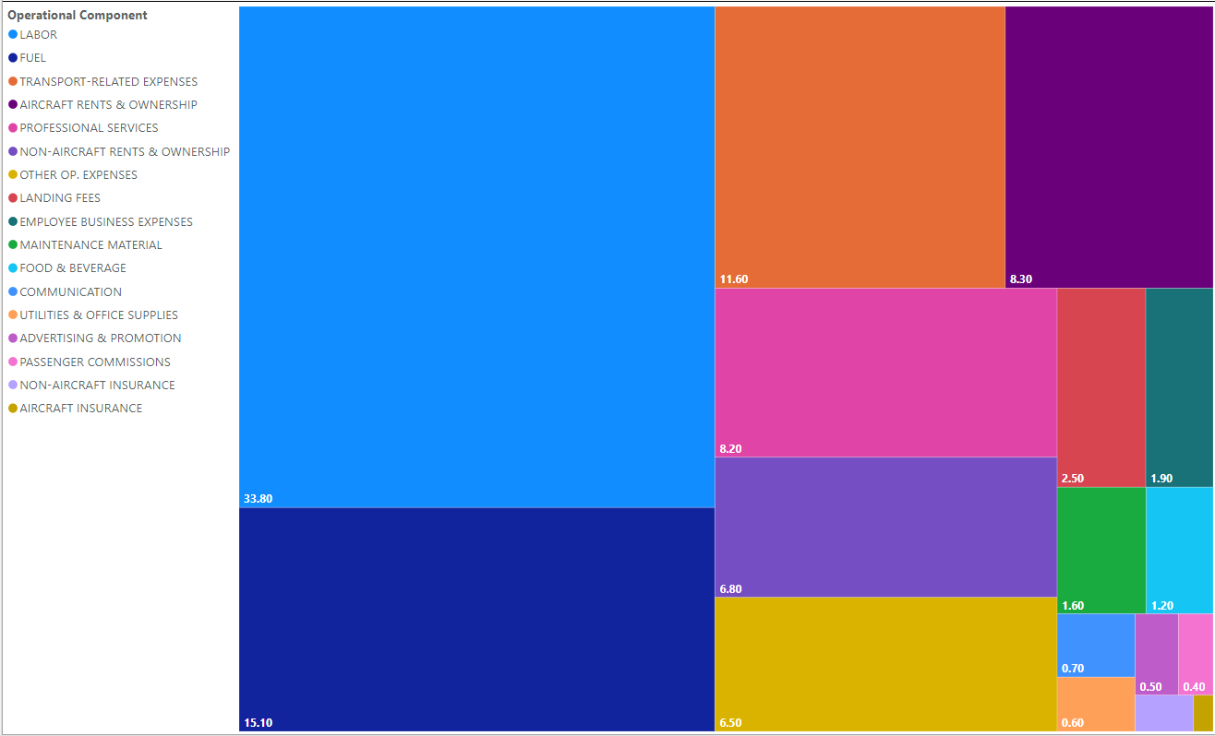
Costing Pressure
Post Covid, Worldwide Inflation Pressure is Impacting Airline Operating Cost
Chart Showing the Updated Operational Components cost in percentage for Q3-2021
Management need to focus on controlling Operation cost by promoting more automation in operations
Source Data : https://www.airlines.org/dataset/a4a-quarterly-passenger-airline-cost-index-u-s-passenger-airlines/

Slide 9
Recommendation
What did Data say?
Airline reported Fatality (worldwide) was way less & not comparable than the total ground fatality reported alone in the USA
Management need to focus on controlling Operation cost by promoting more automation in operations
Management Need to plan for upsizing the fleet capacity for 2022-2023

Slide 10
Legal and ethical considerations
Data Authenticity & PII Disclaimers
During our Analysis we haven’t used any PII data
All Data Sets are extracted from Public Websites.
Used Datasets have no restrictions for Academic usage
All used Datasets are Shared by respective government bodies for public benefits
We have listed the data source details with respectively associated graphs in each slide

Slide 11
References
Data Sources
Used Datasets list in Dashboard:
Accidents and fatalities per year
https://docs.google.com/spreadsheets/d/1SDp7p1y6m7N5xD5_fpOkYOrJvd68V7iy6etXy2cetb8/edit#gid=1448957446
Summary 2017-21
https://docs.google.com/spreadsheets/d/1SDp7p1y6m7N5xD5_fpOkYOrJvd68V7iy6etXy2cetb8/edit#gid=1733053069
Vehical_accident_2019.CSV
https://www.nhtsa.gov/data
airline revenue - supplemental dataset
Power BI web scraping :
http://web.mit.edu/airlinedata/www/2020%2012%20Month%20Documents/Traffic%20and%20Capacity/System%20Total/Passenger%20Revenue%20--%20Total%20System%20Operations.htm")
Economic Impact of Commercial Aviation By State, Airlines for America
https://www.nhtsa.gov/data
https://www.fitchratings.com/research/corporate-finance/global-air-traffic-recovery-will-continue-in-2022-but-risk-remains-30-11-2021
airline_op_cost - supplemental dataset
Power BI web scraping :
https://www.airlines.org/dataset/a4a-quarterly-passenger-airline-cost-index-u-s-passenger-airlines/
https://www.airlines.org/impact/

